Slide 1
CS112 : Introduction to Python Programming
Week 9: lab practice

Slide 2
Practice 1
随机生成一个10*10 的数组，所有元素为0-100的整数，把所有小于10的赋值10，所有大于30的，赋值30.

Slide 3
Practice 2
Create a random 5 × 5 array using the np.random.rand(5, 5) function and compute:
1)the sum of all the entries,
2) the sum and means of the rows and the sum of the columns，
3)sort the array by row and column
4）replace the element is less than mean with the mean of array

Slide 4
Practice 3
Write a program that can place 3 ones randomly into a 4x4 array of zeros (each position has the same probability).
[[0. 0. 0. 0.]
[0. 0. 0. 0.]
[0. 0. 0. 0.]
[0. 0. 0. 0.]]
[[0. 1. 0. 0.]
[0. 0. 0. 0.]
[0. 0. 1. 0.]
[1. 0. 0. 0.]]

Slide 5
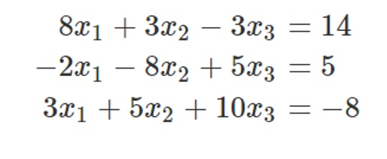
Practice 4
Solve the following equation with SciPy/Numpy

Slide 6
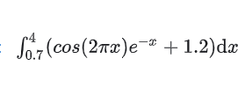
Practice 5
计算下列定积分结果(使用quad函数)

Slide 7
Practice 6
读取health.csv,描述高血压患者的年龄，性别，文化程度，生活习惯，腰围，体重、体质指数等特征(均值、标准差或频数)，比较不同高血压患者的BMI、肥胖率(BMI>28)是否有差异？构建收缩压、舒张压和年龄的回归方程。

